Slide 1


Charging Station
Group No: 30
Guide: Prof. D. P. Kapse
Group Members:
Sagar Ambilpure (A-705)
Aditya Chavan (A-714)
Uzair Chhapra (A-715)

Slide 2


Abstract
Introduction
Literature survey
Problem Statement
Objective
User Demographics
Survey
Proposed System
Block Diagram
Details of Hardware and Software
Conclusion
References

Slide 3

Abstract
Mobile phone is our means to remain connected. While the phones have progressively got more powerful processors and large touch screen interfaces, their power requirement has increased correspondingly. Unfortunately, battery technology has not been growing at a comparable pace. Hence, there is a need to frequently charge the batteries. While travelling, people face a common problem of charging electronic appliances. Most of the cell phone users have experienced having their cell phones run out of battery when they are not near a charging outlet. Our system provides such users an elegant solution to this widespread problem.

Slide 4
Introduction
Currently, when a user's cell phone runs out of battery and there is no charging outlet nearby there very little or nothing that the user can do about it. Even if a charging outlet is available nearby one would have to stay close to the charging outlet until the phone is charged. Our system would provide such users with a solution which would enable them to do other things while the cell phone is being charged without worrying about their phones being stolen. Our charging stations would be located at various public places which would be available for all the registered users. These charging stations would be like vending machines i.e. fully automated using IoT. These charging stations, when placed in stores, would attract more customers & increase dwell time which would consequently increase sales.

Slide 5

Problem Statement
The Problem Statement here is to develop a convenient solution for the widespread issue of mobiles being low on power outside the consumer’s homes and offices.
Mobile phones’ battery getting discharged is a massive issue for every consumer whenever they are on the go.

Slide 6
Objectives
To implement a mobile application to show position of our Mobile Charging station on the map.
To make a Mobile Charging Station and secure it’s open and close locker mechanism using IOT.
To develop a server for our application from where booking requests and user history can be managed.
To provide an API to shopping mall stores for integrating user purchase details with our application.
To provide product recommendations based on purchase history to user in our Charging Station partnered stores.

Slide 7
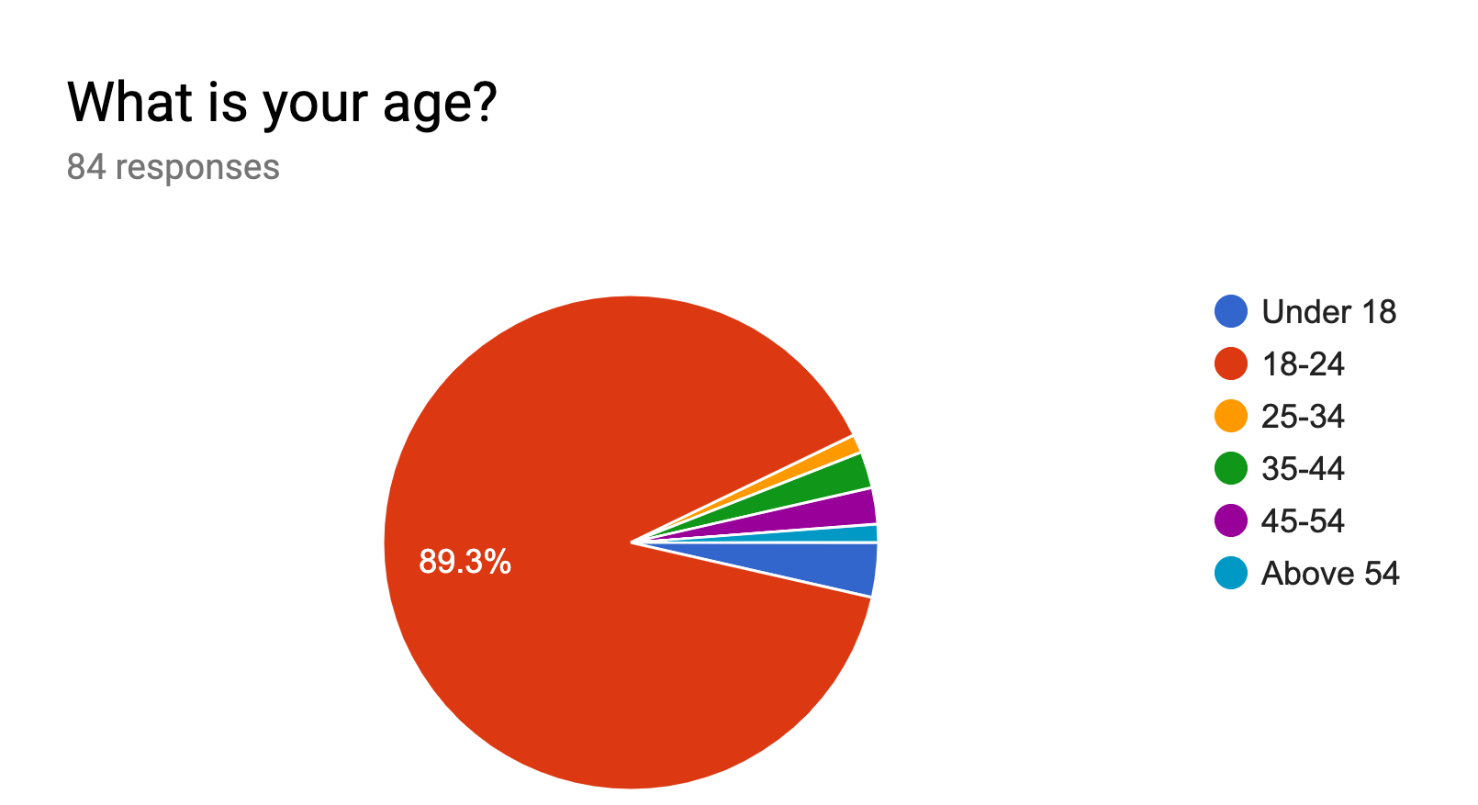

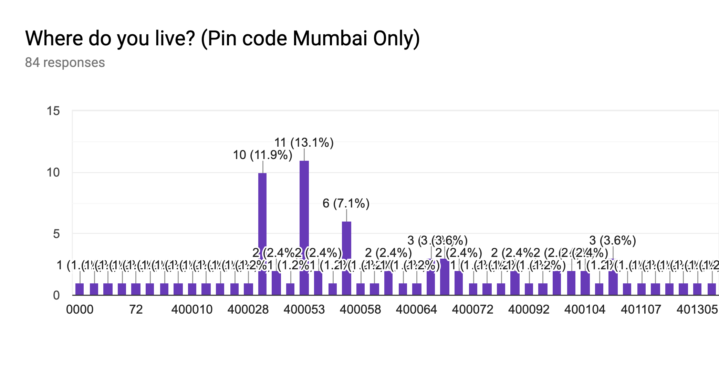
Our User Demographics
The survey we conducted had the following conclusions:
Age groups of our prospective users.
Area codes of our prospective users.

Slide 8
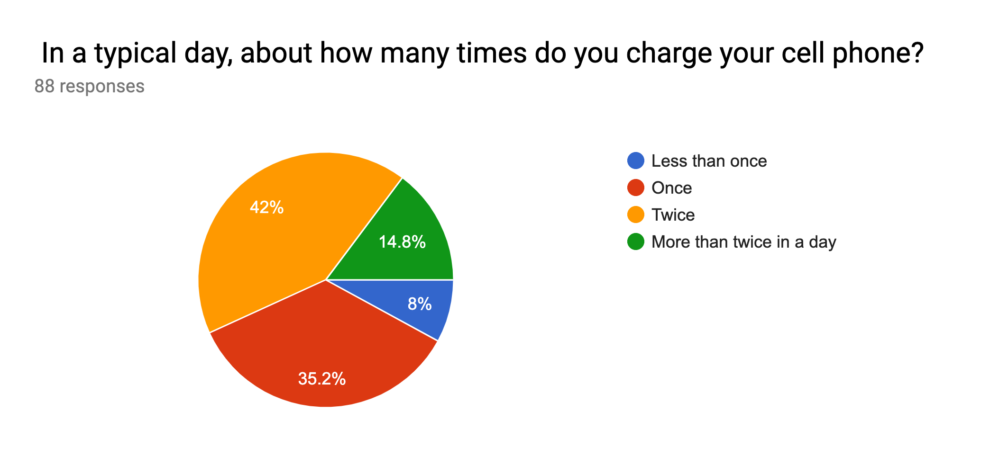
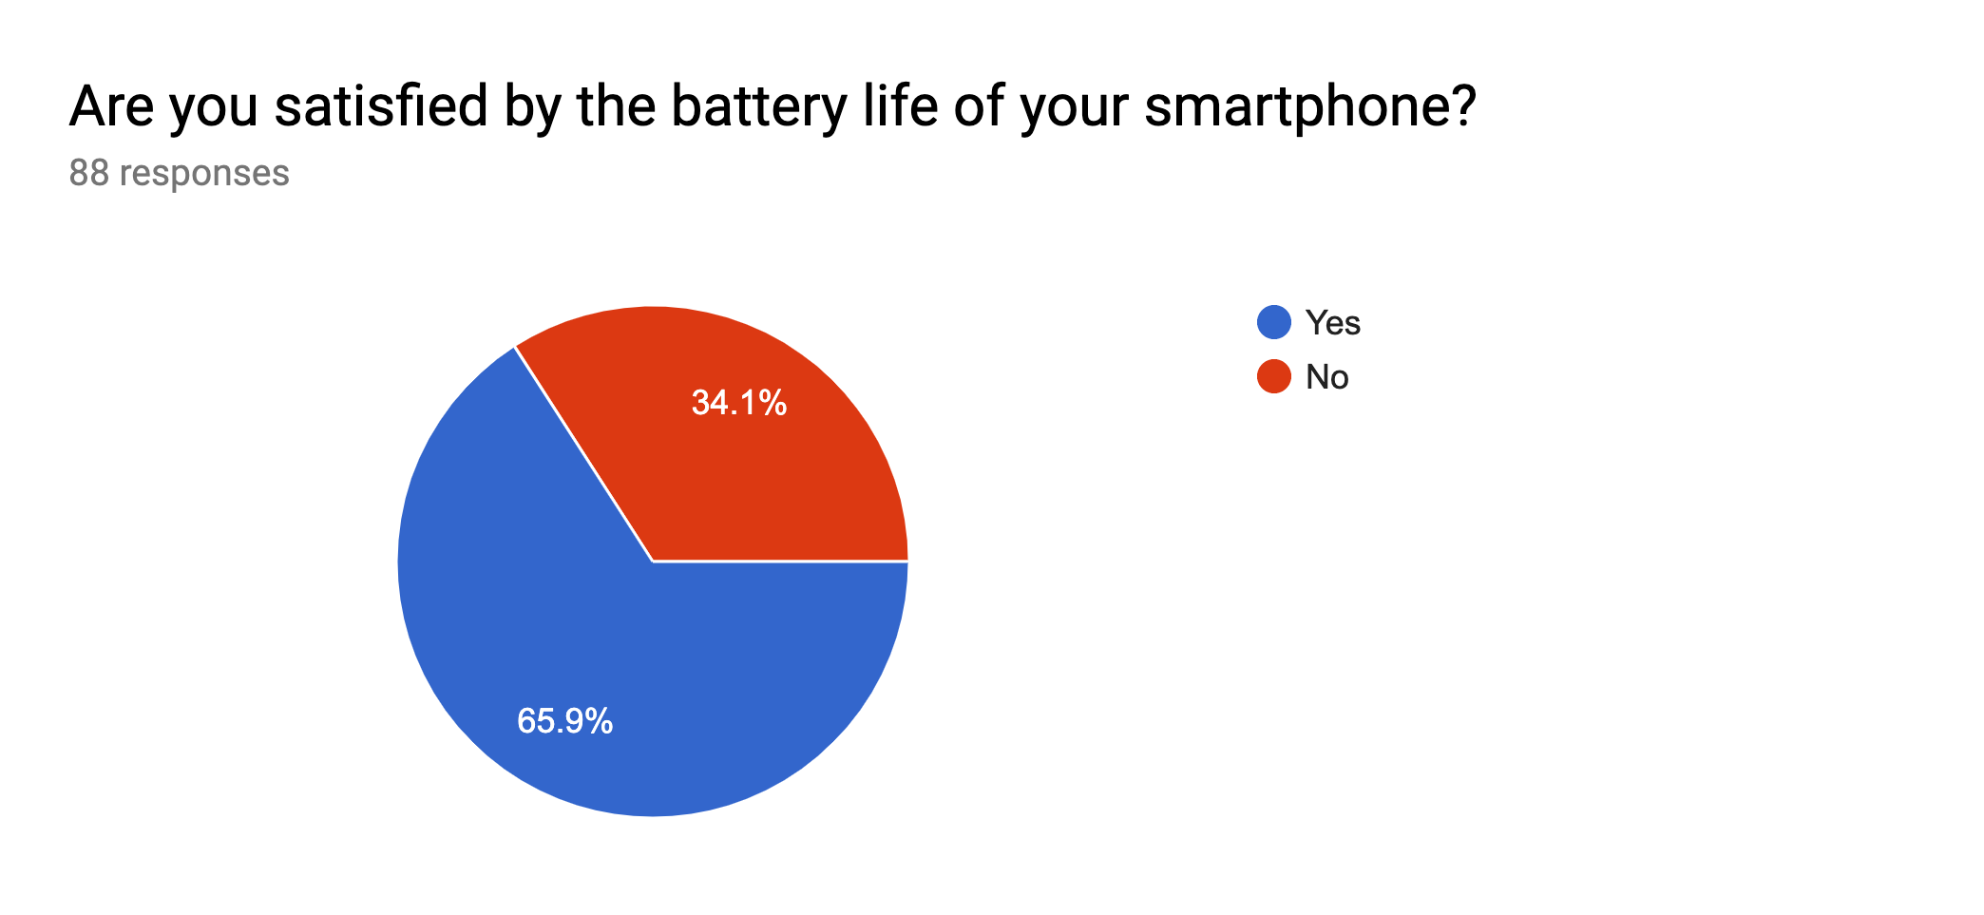
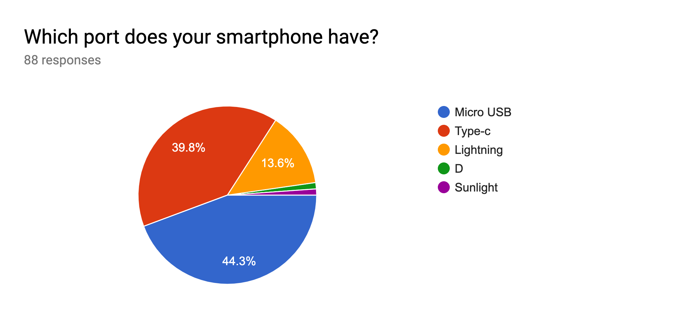
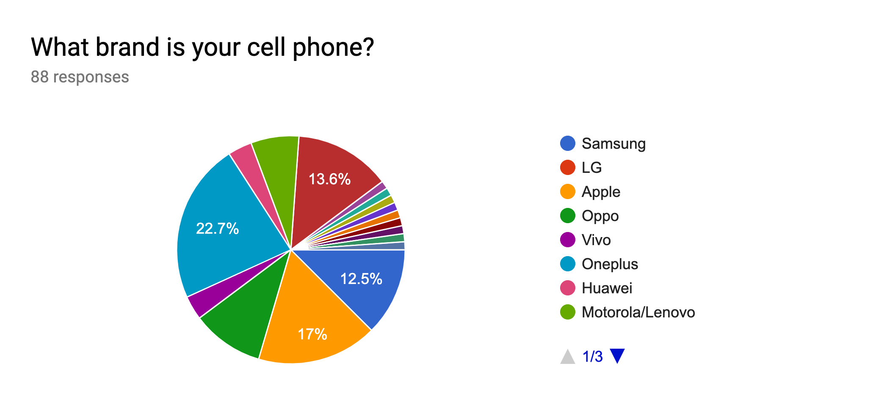
Survey

Slide 9
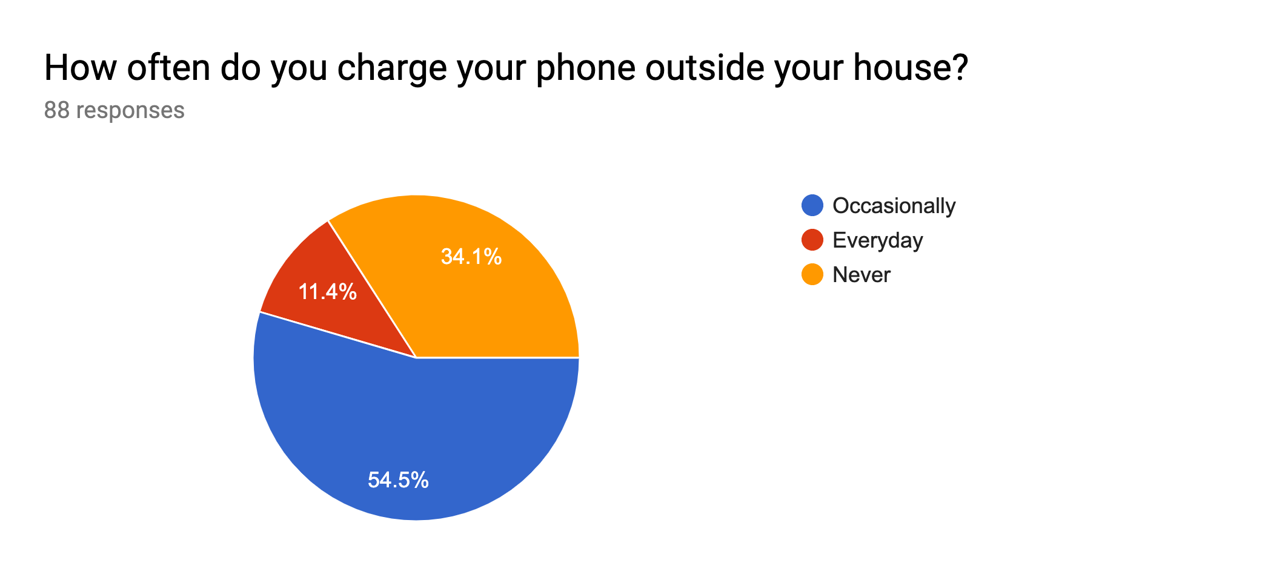
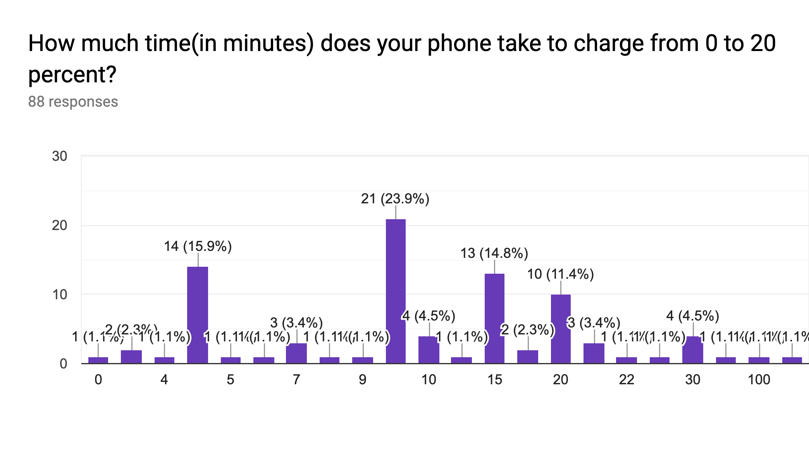
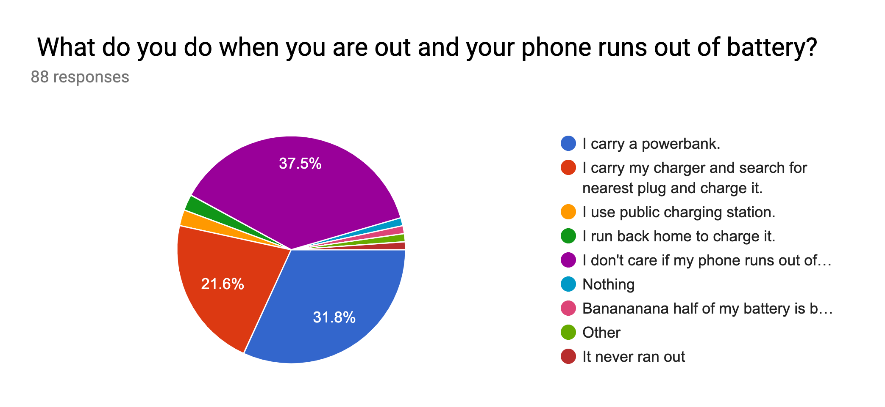
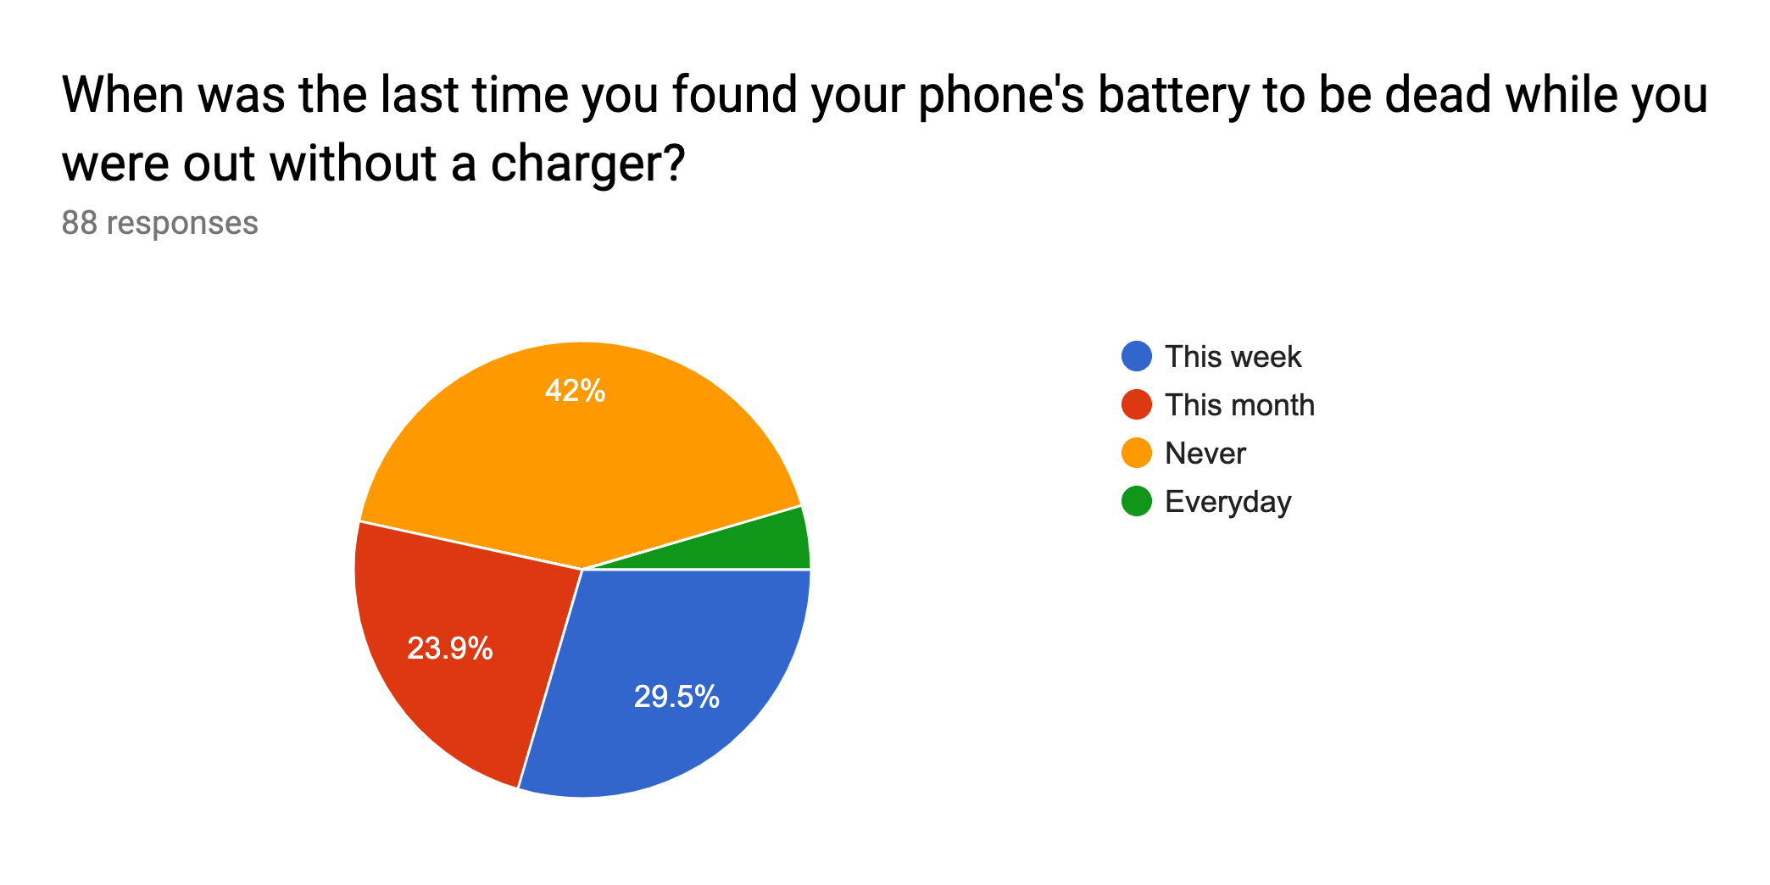

Slide 10
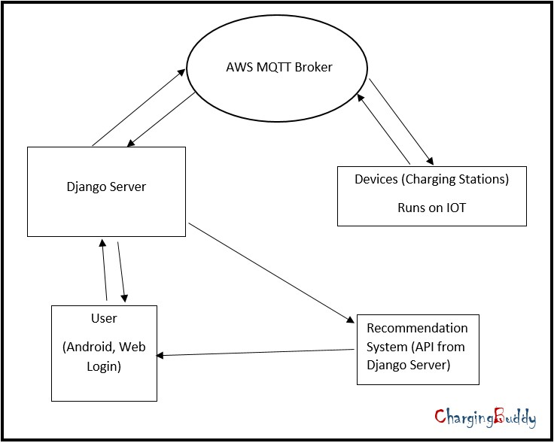
Block Diagram

Slide 11

Algorithms Used
Apriori for Association.
K-Means for Clustering.

Slide 12


Details of Hardware & Software
Django for server.
Raspberry pi as micro-controller.
Electric lock.
AWS Mqtt.

Slide 13

References
https://chargeitspot.com/

Slide 14

Thank you!!

